Slide 1
Market Basket Analysis
Cafe Great Transaction Analysis

Slide 2
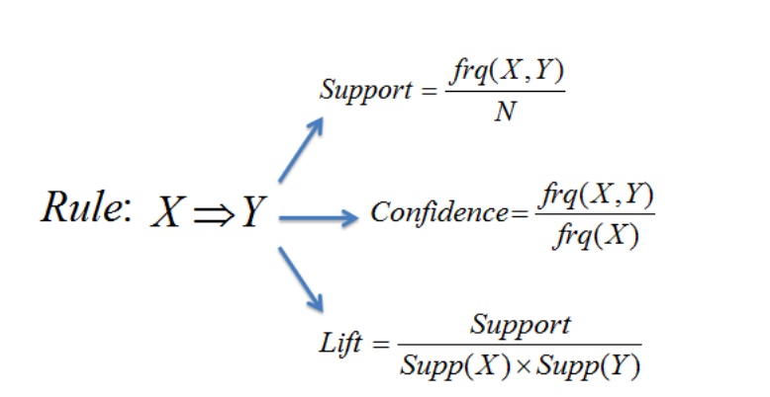
Introduction
Objective:
To understand the sales pattern across different categories with respect to different time frame. Conduct Market Basket Analysis to infer the potential of cross selling and upselling.

Slide 3
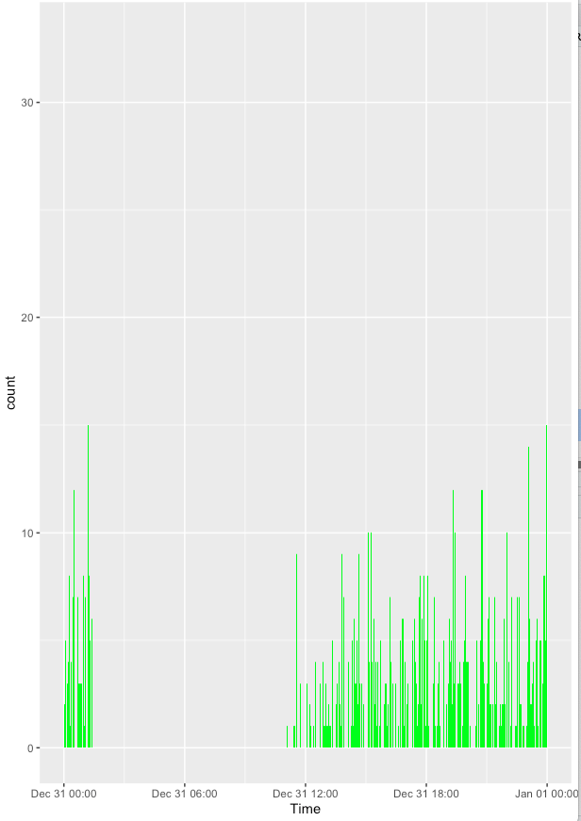
Hourly Count Display

Slide 4
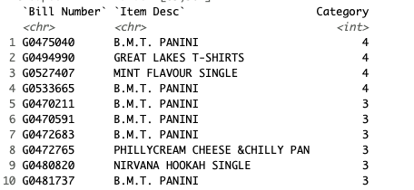
Top 10 products

Slide 5
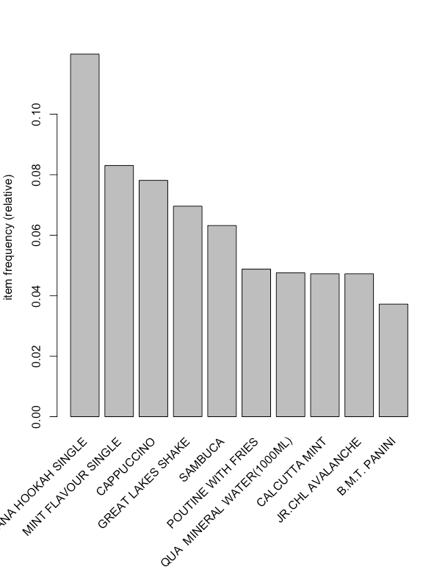
Top 10 combos

Slide 6
Apriori Rule
Apriori
Parameter specification:
confidence minval smax arem aval originalSupport maxtime support minlen maxlen target ext
0.1 0.1 1 none FALSE TRUE 5 0.005 1 4 rules FALSE
Algorithmic control:
filter tree heap memopt load sort verbose
0.1 TRUE TRUE FALSE TRUE 2 TRUE

Slide 7
Apriori Cntd
Absolute minimum support count: 349 set item appearances ...[0 item(s)] done [0.00s].set transactions ...[580 item(s), 69982 transaction(s)] done [0.03s].sorting and recoding items ... [87 item(s)] done [0.00s].creating transaction tree ... done [0.04s].checking subsets of size 1 2 done [0.00s].writing ... [3 rule(s)] done [0.00s].creating S4 object ... done [0.02s].

Slide 8
set of 3 rules rule length distribution (lhs + rhs):sizes1 2 1 2 Min. 1st Qu. Median Mean 3rd Qu. Max. 1.00 1.50 2.00 1.67 2.00 2.00 summary of quality measures: support confidence lift count Min. :0.005 Min. :0.115 Min. :0.96 Min. : 383 1st Qu.:0.006 1st Qu.:0.117 1st Qu.:0.98 1st Qu.: 413 Median :0.006 Median :0.120 Median :1.00 Median : 443 Mean :0.044 Mean :0.122 Mean :1.01 Mean :3072 3rd Qu.:0.063 3rd Qu.:0.125 3rd Qu.:1.04 3rd Qu.:4416 Max. :0.120 Max. :0.130 Max. :1.08 Max. :8389 mining info:data ntransactions support confidence tData 69982 0.005 0.1
>

Slide 9
The distribution of rules by length: a length of 3 items has the most rules.
The summary of quality measures: ranges of support, confidence, and lift.
The information on data mining: total data mined, and the minimum parameters we set earlier.

Slide 10
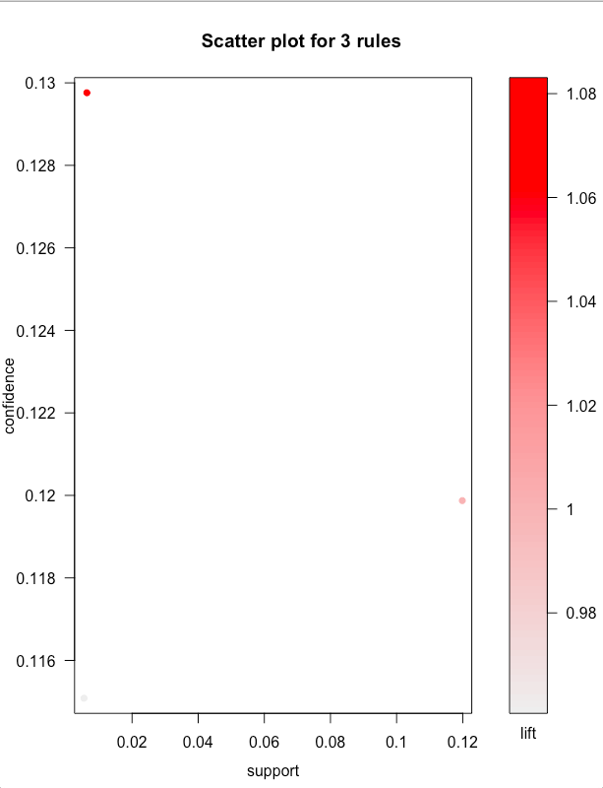
Scatter Plot for 3 Rules

Slide 11
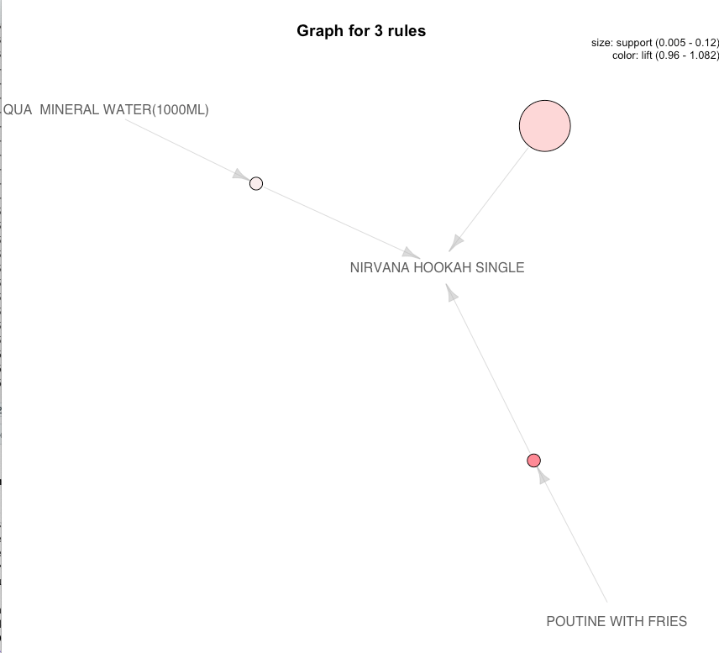
Graphical Representation

Slide 12
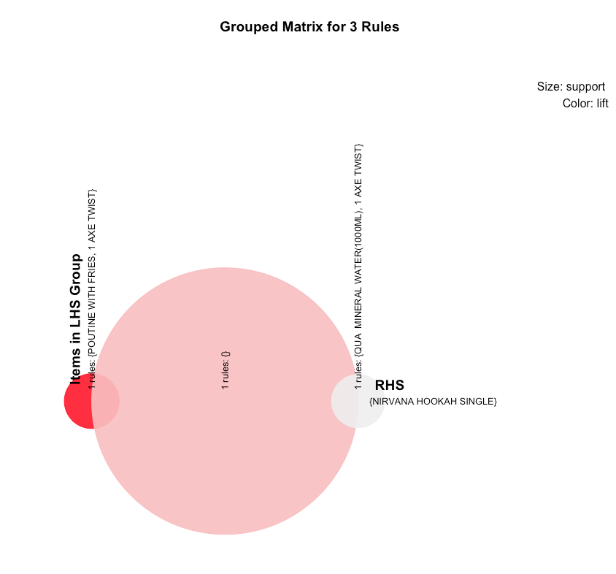
Grouped Matrix

Slide 13
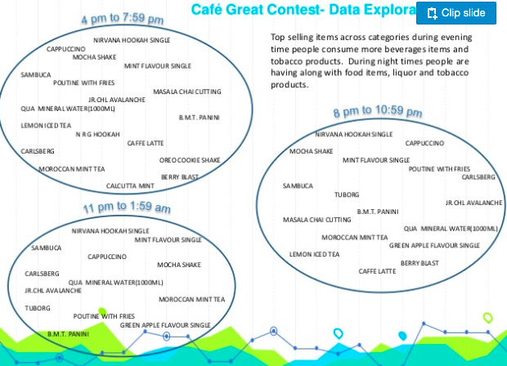
Timely Representation

Slide 14
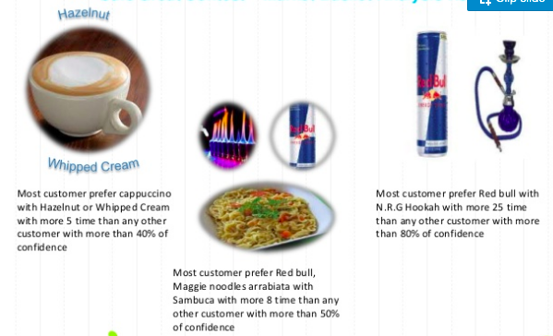
Few Observations

Slide 15
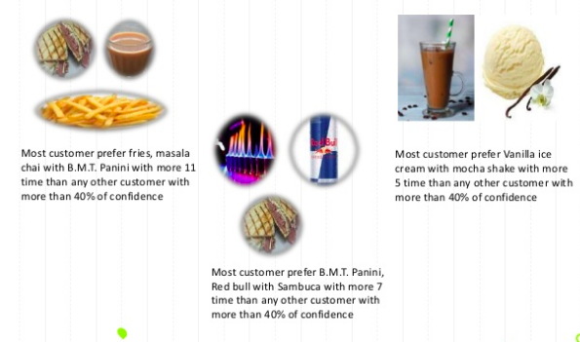
Few Observations Cntd...

Slide 16
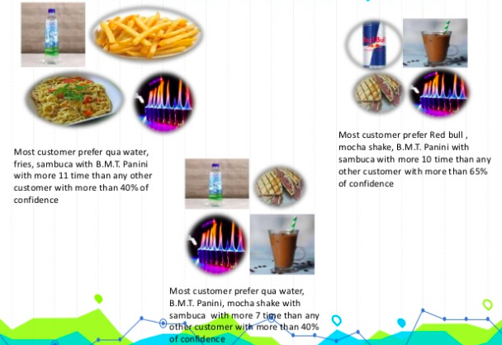
Few Observations Cntd

Slide 17
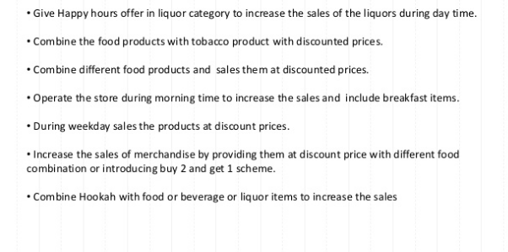
Recommendations

Slide 18
Appendices
References: Analytics Vidhya Jigsaw Academy

